Slide 1


MIS587 Project Presentation
AeroBI Explorers
Team 4

Slide 2
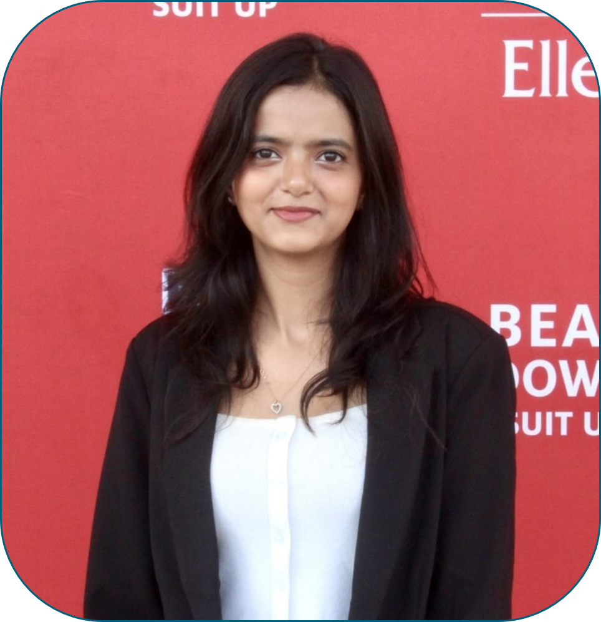
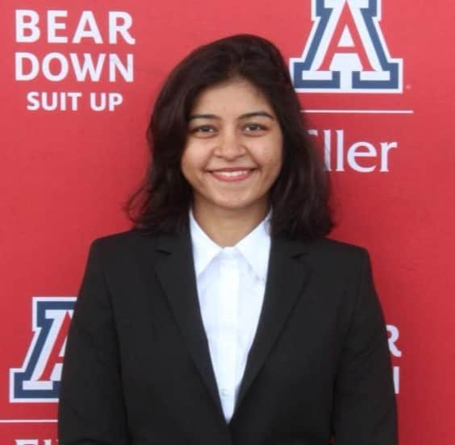
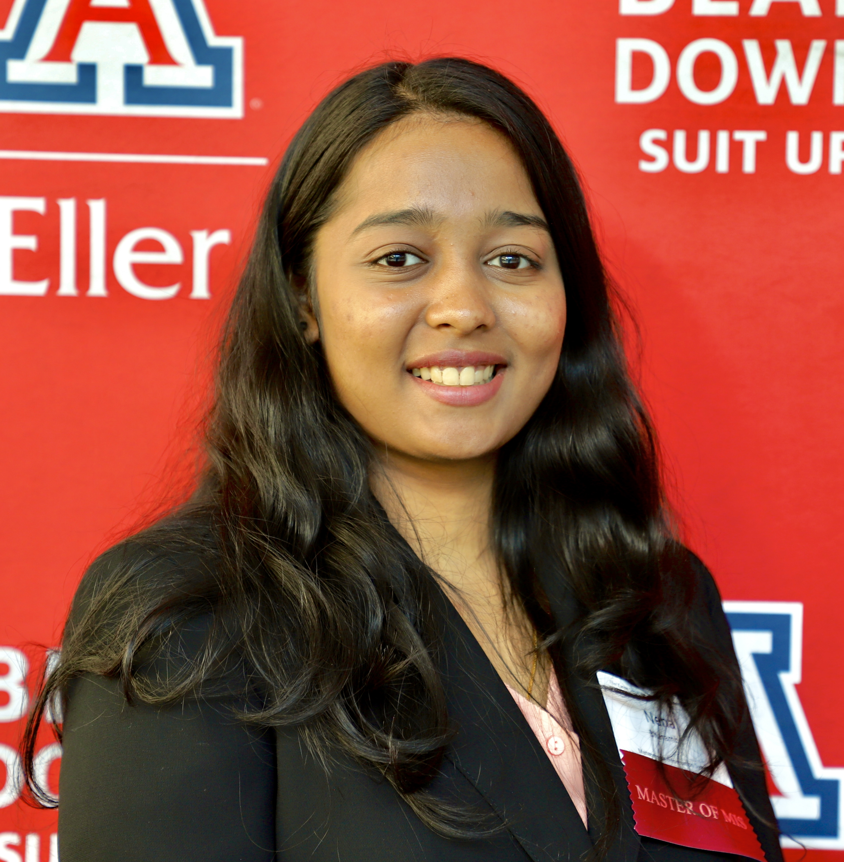

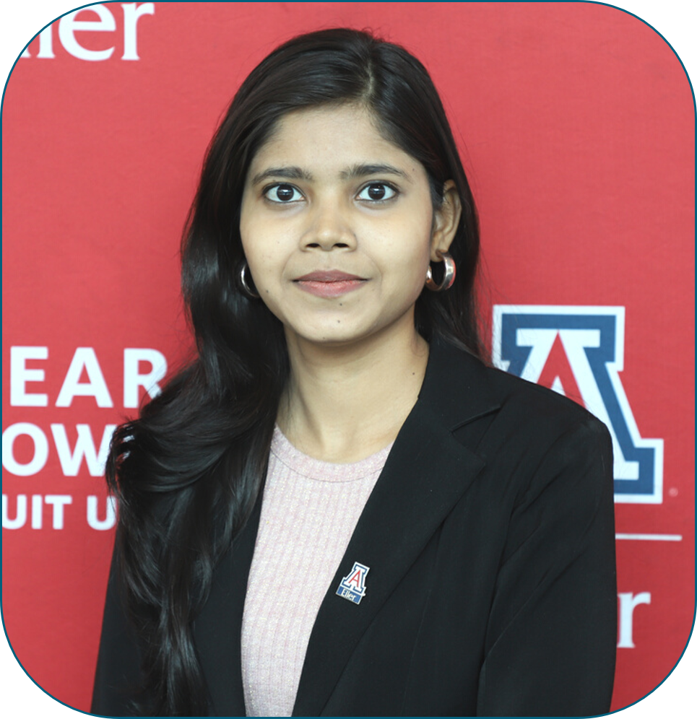
TEAM MEMBERS
Tejaswini
Minita
Neha
Jay
Kanika
Tejaswini

Slide 3












AGENDA
User Persona
Data Preparation
Problem Statement
Data Preprocessing
Dataset
Data Exploration
Design Process
Data Analysis
Star Schema
Visualization
Implementation
Business Implications
Tejaswini

Slide 4

USER PERSONA
PICTURE & NAME | DETAILS | GOAL
Hi, I’m Emily Cooper! | Age: 27 Gender: Female Occupation & Income: Consultant Lifestyle: Attend business meetings globally all year long, Traveler, Extrovert Social class: Upper middle class Personality: Outgoing, Forthright | Make the right choice while choosing airline Avoid routes which are most affected by operational issues
Tejaswini

Slide 5

USER PERSONA
PICTURE & NAME | DETAILS | GOAL
Hi, I’m Alfie Peterson! | Age: 38 Gender: Male Occupation & Income: ATC: Operations Manager Lifestyle: Workaholic, Ambivert Social class: Middle class Personality: Efficient, Strategic Thinker, Work-life Balance | Addressing operational issues Providing recommendations based on insights from product Enhanced decision making
Tejaswini

Slide 6
PROBLEM STATEMENT
Analyzing historical flight data to identify patterns and trends related to delays and cancellations
Analyzing the correlation between various factors and occurrences of delay and cancellations.
Identifying sentiment in customer reviews to uncover key insights and improve customer satisfaction
Tejaswini
Notes:
One of the primary challenges we set out to tackle is analyzing historical flight data to identify meaningful patterns and trends related to flight delays and cancellations.
Another core problem is analyzing the potential correlation between various factors, such as weather, carrier, security or national aviation system.
Additionally, we recognized the importance of incorporating customer feedback and sentiment analysis. By identifying sentiment trends in customer reviews, we can uncover key insights into areas for enhancing customer satisfaction levels.

Slide 7
BALANCED SCORECARD
Lesser cancellations
Profitability
More customers
Fewer delays
Comfort
Financial
Customer
Internal
Learning
Seamless transition to
prepare for the arrival of
the next aircraft
Enhanced aircraft testing
Tejaswini
Notes:
Our project aims to drive improvements across multiple facets represented in this balanced scorecard framework.
From the Financial perspective, the analysis should enable lesser cancellations of flights, increased profitability for airlines, and ultimately attract more customers On the Customer front, it focuses on fewer delays, and targeting airlines with a more comfortable and satisfactory air travel experience.
The Internal Process perspective emphasizes seamless transition and preparation for incoming aircraft arrivals, optimizing turnaround operations
Finally, from a Learning and Growth lens, it stresses on facilitating enhanced aircraft testing procedures
By holistically addressing these interconnected perspectives, it could reap substantial benefits - from cost savings and revenue gains to elevated customer experiences.

Slide 8
DATASET
Flight Delay & Cancellation
Flight delays and cancellations for January 2019 – August 2023
Dataset size – 3M records, 30+ columns
Airline Reviews
Airline experiences through Reviews
Dataset size – 23k+ records, 20 columns
Airports
Airport information across the US
Dataset size – 380 records
Tejaswini

Slide 9
DESIGN PROCESS FOR DW
Business Process
Analyzing trends & patterns and identifying factors for airlines delays and cancellations
Grain
Flight detail
Dimensions
Airlines, Airport, Reviews,
Cancellation, Date
Fact
Cancelled, Delayed, Scheduled Arrival & Departure, Actual Arrival & Departure
Minita

Slide 10
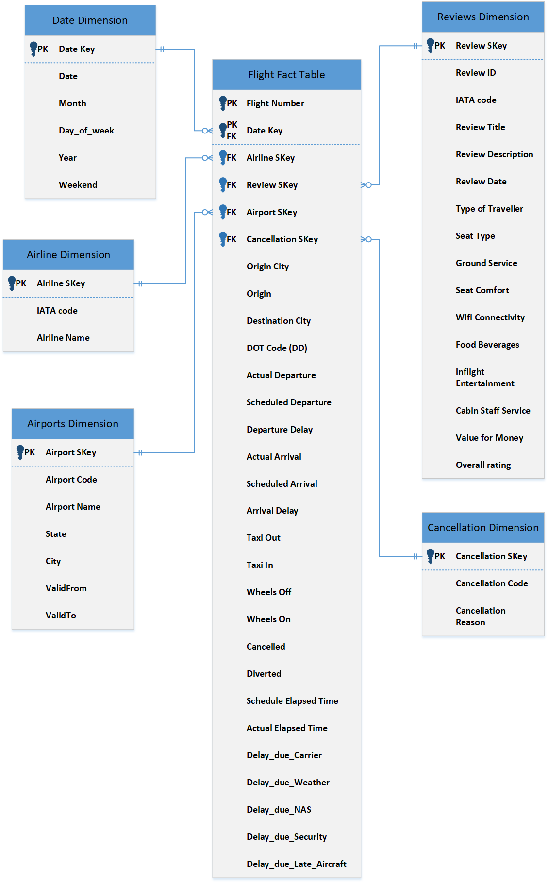
STAR SCHEMA
Minita

Slide 11

DATEWAREHOUSE DETAILS
Degenerate Dimensions
Role Playing Dimensions
DOT Code
Airport
Date
Minita

Slide 12


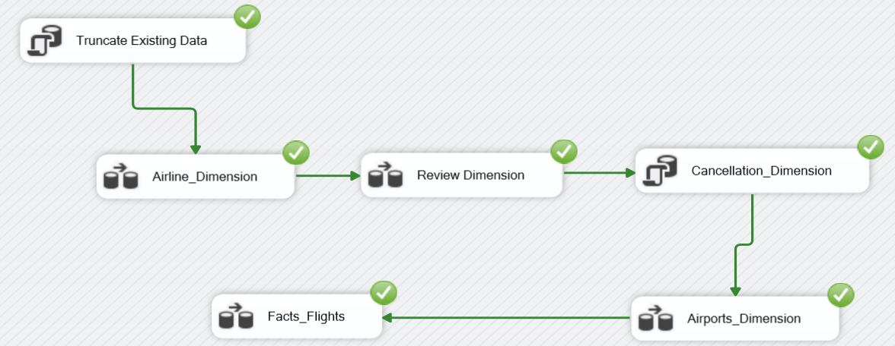


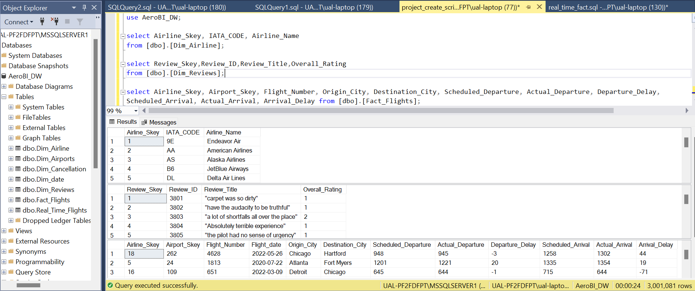

IMPLEMENTATION
Minita

Slide 13
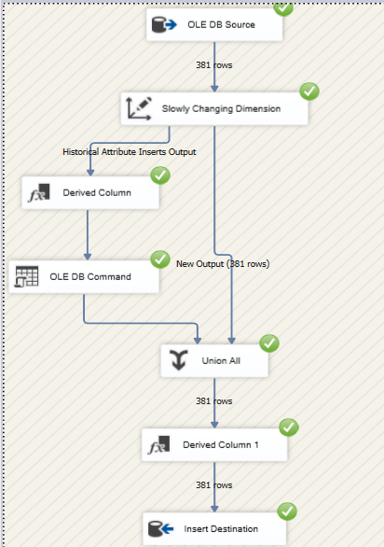
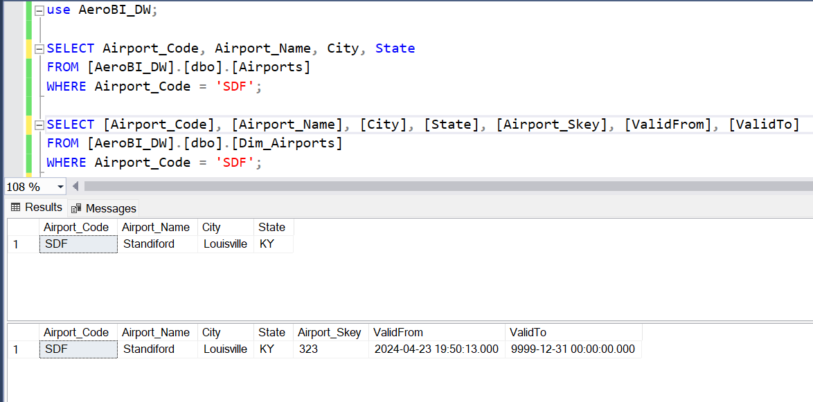
DATA PREPARATION
Minita

Slide 14
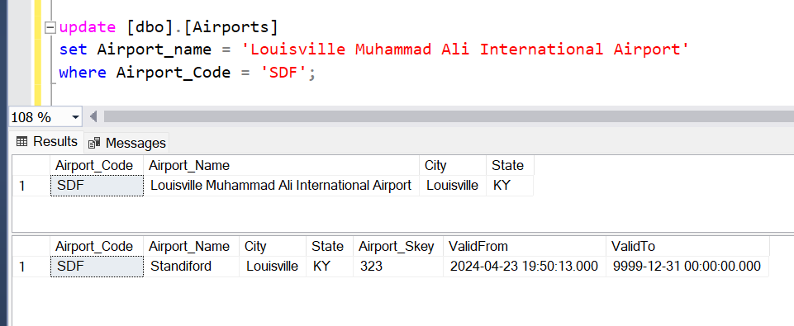
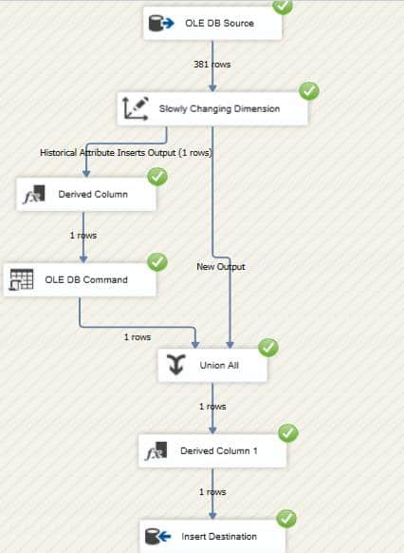
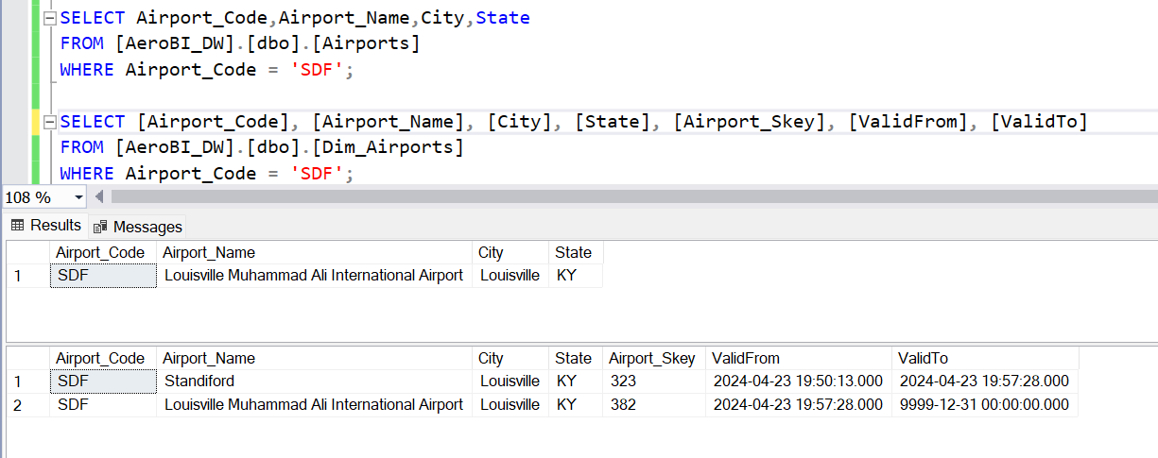
SLOWLY CHANGING DIMENSION
Minita

Slide 15
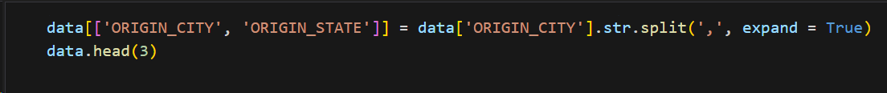
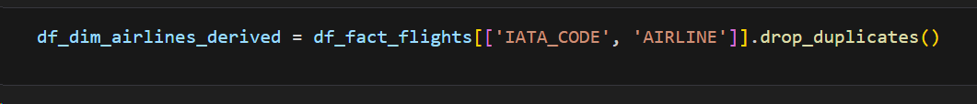
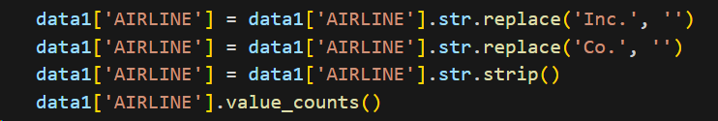
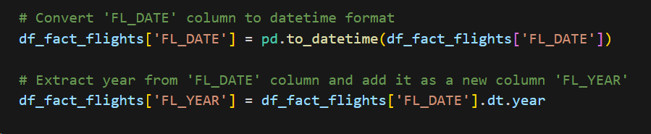
DATA PREPROCESSING
Splitting City and State:
Uses the str.split()
Dropping Duplicates:
drop_duplicates()
Cleaning Airline Names:
Remove unnecessary suffixes and extra white space
Date Manipulation in Flight Data:
Convert string dates to datetime objects
Jay

Slide 16
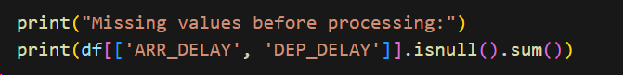
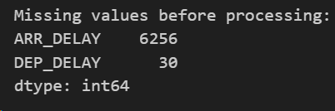
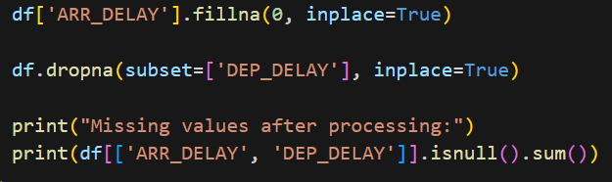
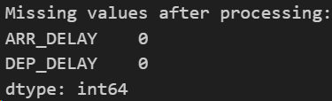
EXPLORATORY DATA ANALYSIS
Handling Missing Data in Flight Records
Missing data treatment focusing on key columns 'ARR_DELAY' and 'DEP_DELAY'
Imputation: Replacing missing values with 0 in 'ARR_DELAY'
Deletion: Rows with missing 'DEP_DELAY' removed
Impact: Ensuring data integrity for reliable analysis.
Significance: Accurate handling of missing data is crucial for robust flight data analysis
Jay

Slide 17


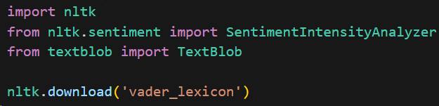
SENTIMENT ANALYSIS OF CUSTOMER REVIEWS
LIBRARIES USED
Jay

Slide 18
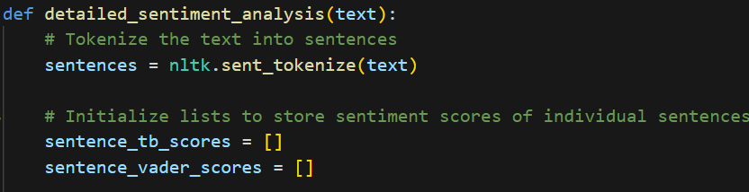

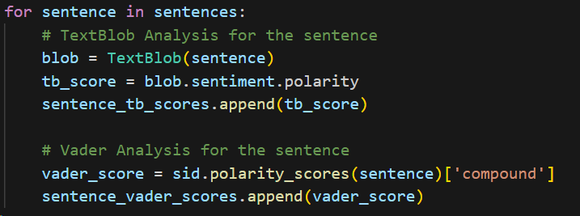



SENTIMENT ANALYSIS OF REVIEWS
Tokenization: The text split into individual sentences
TextBlob to calculate polarity scores
VADER provides a compound score indicating strength and direction.
Jay

Slide 19
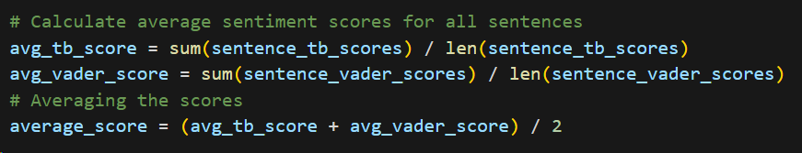

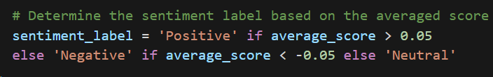

SENTIMENT ANALYSIS OF REVIEWS
Score Aggregation and Final Calculation
Sentiment Label Assignment: Positive, Negative, or Neutral
Jay

Slide 20
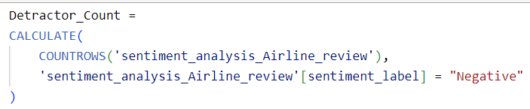
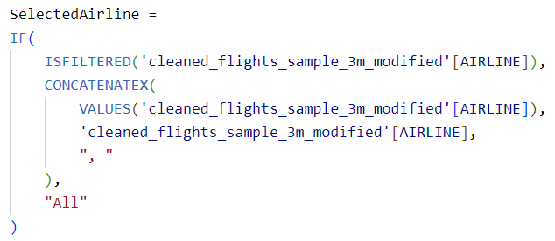
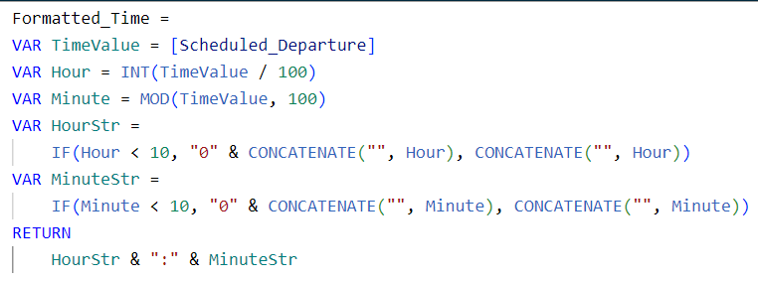
DATA ANALYSIS
Net Promoter Score:
Dataset used: Airline Reviews
Columns: Sentiment Label (categorical)
Airline Performance:
Dataset used: Airlines Dataset
Columns: Arrival Delay, Departure Delay, Delay Reason, Cancellation Reason
Real-Time Dashboard:
Dataset used: Airline Dataset
Columns: Scheduled Departure, Departure Delay, Delay Reason
Neha

Slide 21
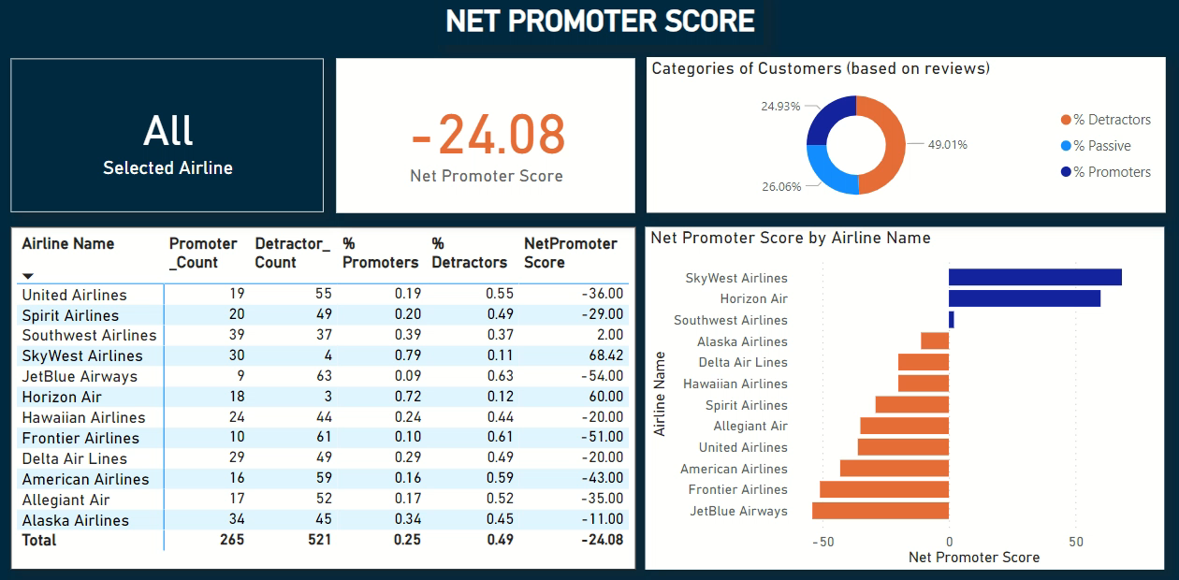
VISUALIZATION
Neha

Slide 22
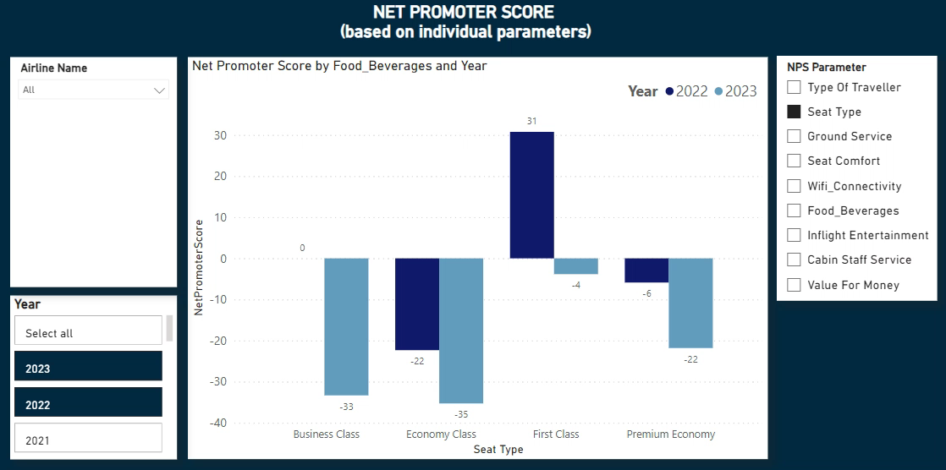
VISUALIZATION
Neha

Slide 23
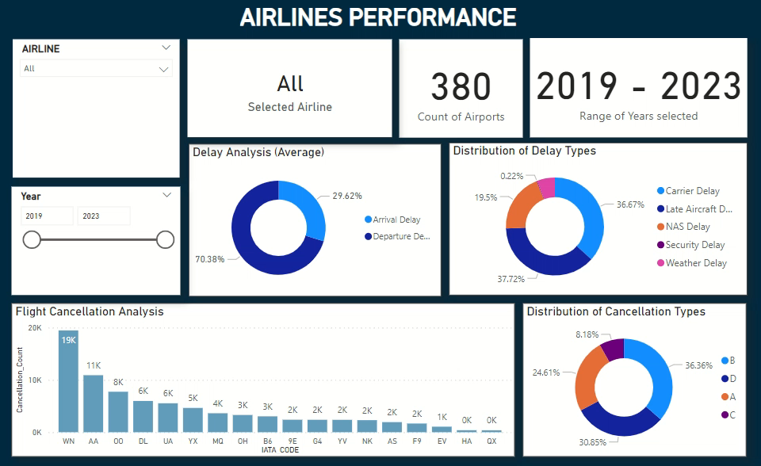
VISUALIZATION
Neha

Slide 24

TRACK MY FLIGHT
LIVE DEMONSTRATION
Neha

Slide 25
BUSINESS IMPLICATIONS
Net Promoter Score
Management
Airline Performance
Airline managers
Real-Time Dashboard
Marketing Team
Analysts
Travelers
Investors
Operations staff
Customer service staff
Passengers
Airlines
Freight forwarders
Travel Agent
Kanika

Slide 26







TOOLS & FRAMEWORKS USED
Kanika

Slide 27

KEY LEARNINGS
ETL
Data Warehouse
Data Modelling
Star Schema
Role Playing Dimension
Degenerate Dimension
Sentiment Analysis
Vectorization
Power BI Visualization
Tokenization
SSIS
Slowly Changing Dimensions
Kanika

Slide 28


QUESTIONS

Slide 29

INDEX
User Persona
Data Preparation
Problem Statement
Data Preprocessing
Dataset
Data Exploration
Design Process
Data Analysis
Star Schema
Visualization
Implementation
Business Implications

Slide 30

THANK YOU

